Slide 1

Thousands of Tables and Four Farthings
Hacking Your Way to a Better Report
The Great ILS-Data Pre-Conference
Daniel Messer
Polaris ILS Administrator
Library Systems & Services

Slide 2

Hello, I’m Dan
I like bright text on dark backgrounds

Slide 3
Hello, I’m Dan
I like bright text on dark backgrounds
30 years in libraries
Polaris ILS admin for Library Systems & Services
SQL Hacker (as will soon be made clear)

Slide 4
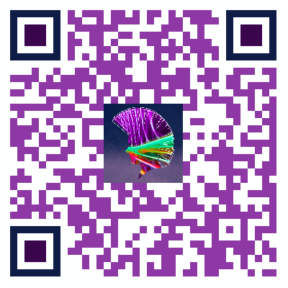
https://cyberpunklibrarian.com/iug2026

Slide 5
Beginning at the Beginning – WTF is Four Farthings?
De-centralized central data server
Wait what?
I have a weird relationship with libraries and Polaris
I do not help manage Polaris for a library or a consortium
I help manage Polaris for 27 libraries
10 of which are in consortia (of which there are two)
We would like to be able to do things with the data between them
But we don’t want to move that data around

Slide 6
Okay, sure but why Four Farthings?
My boss is a huge fan of Lord of the Rings
Me, I love Lord of the Rings
But she has forgotten more about Lord of the Rings than I know
Rumour has it that she read The Silmarillion and enjoyed it
All that to say, is that The Shire is divided into four parts
The Four Farthings

Slide 7
The Problem
The Finance Department
No that’s it, they’re the problem
Okay they run this report to get paid invoices, right?
But do they do it through SSRS?
No
Through the Polaris reporting system?
No
SimplyReports?
No

Slide 8
The Problem – Continued
No, they run a custom SQL query in the Find Tool
Select all the Invoices
Right-click
Select Print -> Full
A PDF appears from… somewhere
Yeah…

Slide 9
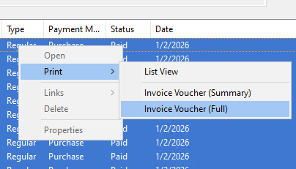

Slide 10
Analysis
So this is obviously coming from some kind of internal reporting process
But where is it and how does it work?

Slide 11
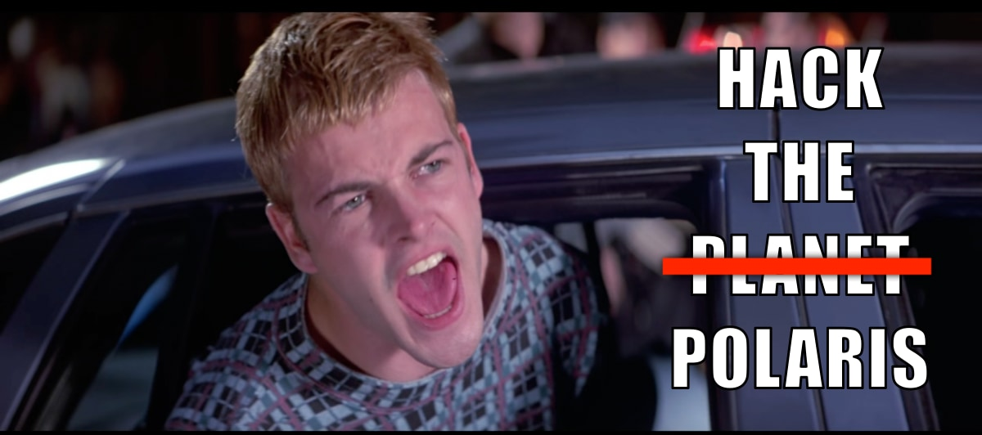
Solution

Slide 12
Where’s the Call Coming From?
Inside the house, obviously
So let’s trace the call

Slide 13
SQL Server Profiler
A separate programme that works with SQL Server
Allows you to do a SQL Trace
Watch everything that’s happening in your database
Set up and run the search in the Find Tool
Start the trace
Select and print the full invoice vouchers
Stop the trace
Look for clues

Slide 14
Interesting Finds
exec ObjectExists @Path=N'/Polaris/System/Internal/Vouchers1',@AuthType=1
exec Polaris.Rpt_Vouchers1 @InvoiceID=1,@PayHistoryID=1,@sTempTable=N'##6_861’
Ran a search on that @Path and, oh hey:
C:\ProgramData\Polaris\{POLARIS VERSION}\Reports\System\Internal

Slide 15
SQL Server Extended Events
The SQL Profiler Trace casts a very wide net but…
Now we have some idea of which fish we want to catch
Time for Extended Events
Set up a search
sql_batch_completed
rpc_completed
These capture sproc calls and ad-hoc queries
Filter by username. In this case: polaris

Slide 16
More Interesting Finds
Looking through the captured data, you can see the order
declare @p3 nvarchar(255) set @p3=N'##1158_861' exec Polaris.Rpt_CreateTempTable 861,1158,@p3 output select @p3
exec Polaris.Rpt_Vouchers1 @InvoiceID=1,@PayHistoryID=1,@sTempTable=N'##1158_861’
exec Polaris.Rpt_VoucherLines @invoiceid=317773,@payhistoryid=325569

Slide 17
So what did we discover?
There’s an internal report, not shown in SSRS, called Vouchers1
There are three sprocs involved:
Rpt_CreateTempTable
Rpt_Vouchers1
Rpt_VoucherLines
And we can look at the way the sprocs are called and compare that with their code to find out what parameters they take
Rpt_CreateTempTable takes the PolarisUserID, WorkstationID, and a table name
Which means it creates a predictably named table

Slide 18
Know the Process, Hack the Process
We need to create our own temp table
EXEC Polaris.Polaris.Rpt_CreateTempTable 861,1158,@p3 OUTPUT;
Populate the table with our own SQL query, the same one Finance was using but with variable start and end dates
EXEC Polaris.Polaris.Rpt_Vouchers1 @InvoiceID = 1, @PayHistoryID = 1, @sTempTable = N'##1158_861’
But wait! What about Rpt_VoucherLines?
Turns out, it’s only used as a sub-report in the Vouchers1 RDL file

Slide 19
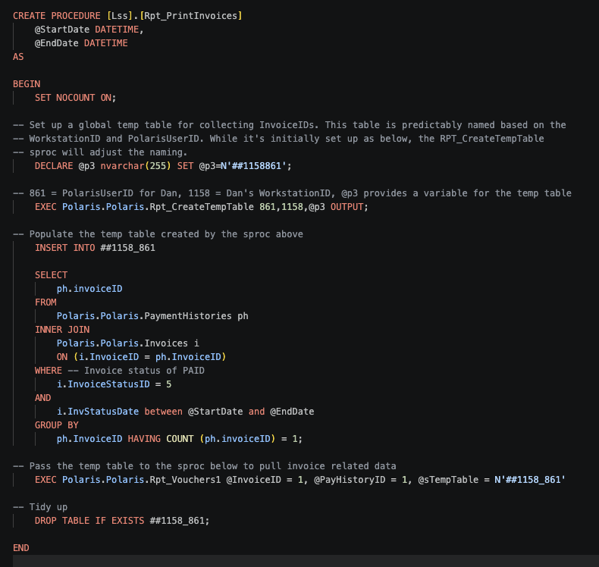

Slide 20
Thank you!

